Slide 1
Web Application
Developed using
J2EE API’s such as
JDBC
Servlets
JSP
Java Mail
etc.,
Operating System
Web Server Application
Request
Response
Request
Browser
Application
Response
Our Own
Computer
Computer / Server

Slide 2


Hotel Server
Brings the Dosa
From Kitchen
Request : Dosa
Kitchen
Gives the Dosa to You.
i.e. he is serving your
request
i.e. Server is Controlling the Kitchen
For others “Entry Restricted”
He acts as a bridge between You &
Kitchen
You
User using Browser
makes request to
Web Server
Web Server Application
installed on server OS
Web Application which is under
Control of web server

Slide 3
WAR
META-INF
MANIFEST.MF
WEB-INF
web.xml
classes
Contains .class files
lib
Contains dependent JAR files
Folder 1
Contains JSP Files, Static Resources
(HTML, Text, PDF, etc.). In-other words
any non-Java files
Folder 1
Non Java files

Slide 4

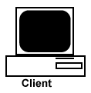
1
http://localhost:8080/studentsApp/myFirstServlet
2
http://localhost:8080/studentsApp/anotherServlet
3
http://localhost:8080/studentsApp/anotherServlet
4
<HTML>
-----
-----
</HTML>
User makes the request to a servlet
Servlet redirects that request to another resource (Internal / External). In this case Browser gets the URL as a response
Browser makes a New Request to this URL. When we redirect the request, it is always be a GET request
Browser displays the whatever the response given by the new URL. Redirect happens at Browser side & in case of Redirect URL in the browser changes
To redirect the request call sendRedirect() on the HttpServletResponse object

Slide 5
1
Servlet 1
http://localhost:8080/studentsApp/myServlet
2
doXXX (req, res)
3
<HTML>
-----
-----
</HTML>
Servlet 2
User makes a request to a servlet
Servlet internally forwards that request to another servlet by passing Request & Response objects (i.e. forward happens at Server side). Another servlet handles that request & gives back the response.
Browser displays the response. In this case Browser will not have any clue on what went behind the scene. Also, URL in the browser doesn't change.
To forward the request call forward() on the RequestDispatcher object. There are two ways we can get the RequestDispatcher object

Slide 6
HTTP Request
Browser
HTTP Response
Key elements of HTTP Request are :
Web URL
Form Data (if any)
HTTP Method
Cookies (if any)
Key elements of HTTP Response are :
Status code
Actual Content (if any)
Content Type (if any)
Cookies (if any)

Slide 7
HTTP Request
HTTP Response
Whenever Browser makes a request to some server, it always checks whether it has any Cookies within it which are tagged to that server. If yes, then it will send those Cookies to server along with the “Request”
1. Let say Browser makes the First Request to “localhost”. It checks whether it has any Cookies within it which are tagged to localhost. Since it a First request, it won’t find & hence request won’t have any cookies.
3. Browser receives the response, gets the Cookie & stores it into it’s memory.
4. Browser makes second request. This time Cookie is sent along with the request
Server gets the request along with cookies (if any). It process the request & it “may / may not” send the Cookies (by setting it’s lifetime) along with the “Response”
2. Server gets the request, it process the request, creates the Cookie & sets it’s lifetime & sends it to Browser along with the response
5. Server gets the request along with cookie, it process the request, it “may / may not” send the Cookies along with the response

Slide 8
1
2
Webserver Application
Helper Technologies
4
3

Slide 9
Server Machine
1
Web Server
6
<html>
----
----
</html>
5
2
3A
Servlet Name
web.xml
Servlet Container
3B
Thread’s run() Method
Servlet Service()
4
<html>
----
----
</html>
doXXX()

Slide 10
Servlet Hierarchy
Servlet
ServletConfig
Interfaces
GenericServlet
Abstract Class
Not Specific to any protocol
Abstract Class
Handles ONLY
HTTP & HTTPS Protocols
HttpServlet
MyServlet
Concrete class

Slide 11
Interface
It provides request information
to a particular servlet
A ServletRequest provides request data
including parameter name and values,
attributes and an input stream
ServletRequest
Interface
It extends the ServletRequest Interface
to provide request information for HTTP servlets
HttpServletRequest

Slide 12
Interface
It assist’s the servlet in sending a response
To send Character Data use PrintWriter
PrintWriter out = response.getWriter();
To send Binary Data use ServletOutputStream
ServletOutputStream out = response.getOutputStream();
To create a multipart response (mixture of binary and
text data) use a ServletOutputStream and manage the
character sections manually
ServletResponse
Interface
It extends the ServletResponse Interface
to provide response information for HTTP servlets
It has methods to access HTTP headers and cookies
HttpServletResponse

Slide 13
Servlet Container
Container loads the
servlet whenever it
receives the First Request
for that servlet
Load
web.xml
Success
Instantiate
Invoke Default Constructor
Failure
Success
Initialize
Invoke init(ServletConfig) method
Request
Success
Service
Invoke service(SR, SR) method
doXXX (HSR, HSR)
Response
Destroy
Invoke destroy() method
Unload

Slide 14
Load
If necessary, Container
loads the JSP whenever it
receives the First Request
for that JSP
web.xml
Servlet Container
Success
Translate
Parse the JSP
Translating the JSP into a servlet
Compile the servlet
Success
Failure
Instantiate
Invoke Default Constructor
Success
Initialize
Invoke jspInit() method
Success
Request
Service
Invoke _jspService(HSR, HSR) method
Response
Destroy
Invoke jspDestroy() method
Unload

Slide 15
Servelet Container
Initial Request (NO Session)
A New Unique Session ID is created & user's
on-going transaction info is stored at server side
using Session Attributes against this ID as shown
1
Cookie with Name=JSESSIONID
& Value= 1234 is sent to Browser
along with First Response
JSESSIONID = 1234
Name | Value
myName | Praveen D
someObj | Any Java Object
2
Whenever user makes any future
requests, browser will send this
cookie to the servlet container
If needed, edit the Session Attributes (add / replace /
remove) which are stored against the supplied
JSESSIONID at server side
3
User is redirected to Login Page.
Once user clicks on the Logout link, invalidate the
session. This will remove all the Session Attributes
which are stored against JSESSIONID = 1234
4

Slide 16
Tier 1
Tier 2
Client Machine
Database Server
JDBC
API
Driver
Java
Database

Slide 17
JSP Tags
Declaration Tag
Include Action
Expression Tag
Scriptlet Tag
Action Tag
Forward Action
Use Bean action
Directive Tag
Include Directive
Tag Lib Directive
Page Directive
language
info
contentType
import
autoFlush
extends
buffer
session

Slide 18
Scope = Page
Scope = Request
Scope = Session
Scope = Application
id = objID
id = objID
id = objID
id = objID
Object
Object
Object
Object

Slide 19

Common Language
Language Examples:
Kannada
Telugu
Greek
English (Most Widely Used Language)
User 1
User 2
Web Browser
Web Server
Protocol ( Common Language )
Protocol Examples:
TCP (Transmission Control Protocol)
IP (Internet Protocol)
WAP (Wireless Application Protocol)
HTTP & HTTPS (Most Widely Used Protocols)

Slide 20
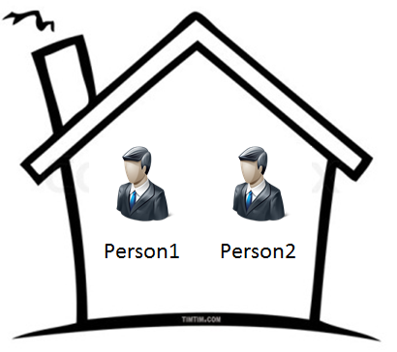
House Address
#123, 5th Cross, 6th Main, ABC Nagar, Bangalore
Person 1 Address
Person 1,
#123, 5th Cross, 6th Main, ABC Nagar, Bangalore
Person 2 Address
Person 2,
#123, 5th Cross, 6th Main, ABC Nagar, Bangalore
StudentsApp Application
Application URL
Http://localhost:8080/studentsApp
HTML URL
Http://localhost:8080/studentsApp/index.html
Servlet URL
Http://localhost:8080/studentsApp/currentDate
HTML
Servlet

Slide 21

Your Friend
You
Request for 1000/- Rs
Reject the Request by telling NO
1
Accept he Request & give 1000 Rs
2
Redirect the Request by
Referring another Person Name
3
Take the help of your another friend
& fulfill your friend request (Forward the Request)
4

Slide 22
Request for 1000/- Rs
You
Your Friend
Redirect the Request by
Referring another Person Name
let say person ABC
1
Now Your Friend make a New Request
for 1000/- Rs to the person referred by you
Your Friend
ABC
2
Accept he Request & give 1000 Rs

Slide 23
Your Friend
Request for 1000/- Rs
You
Your friend gets the Money but he will not be aware of what went behind the scene
1
You may not have the Money.
But you want to fulfill your
friend request. Hence you take the
help of you own friend
(Forward the Request)
Accept he Request
& give 1000 Rs
ABC

Slide 24
web.xml
(Session Timeout)
For ex : 30 Min
Tomcat Server
3rd Priority
web.xml
(Session Timeout)
For ex : 15 Min
Application 1
Order of Priority
2nd Priority
web.xml
(Session Timeout)
For ex : 5Min
P1
1st Priority

Slide 25
Flow 1 :- Session ID NOT Present
Flow 2 :- Session ID Present
but In-Active
Flow 3 :- Session ID Present
and Active
Request
Session ID is
Present in Cookies ?
No
1
Yes
Session ID is
Active @ Server Side ?
No
2
Yes
3
No
Returns the Current Session Object | Returns the New Session Object
 | Returns NULL
getSession(true)
getSession(false)

Slide 26
Flow 1 :- Session ID NOT Present
in the Request
Flow 2 :- Session ID Present
but In-Active
Flow 3 :- Session ID Present
and Active
Request
Session ID is
Present in Cookies ?
No
Yes
Yes
Session ID is Present in URL ?
Session ID is
Active @ Server Side ?
No
No
1
2
Yes
3
Returns the Current Session Object | Returns the New Session Object
 | Returns NULL
getSession(true)
getSession(false)

Slide 27
Flow 1 :- Session ID NOT Present
in the Request
Flow 2 :- Session ID Present
but In-Active
Flow 3 :- Session ID Present
and Active
Request
Session ID is
Present in Cookies ?
No
Yes
Yes
Session ID is Present in URL ?
Session ID is
Active @ Server Side ?
No
No
1
2
Yes
3
Returns the Current Session Object | Returns the New Session Object
 | Returns NULL
getSession(true)
getSession(false)

Slide 28
Request
Session ID is
Present in Cookies ?
No
Yes
Yes
Session ID is Present in URL ?
Session ID is
Active @ Server Side ?
No
Yes
No
getSession()
&
getSession(true)
Returns the Current Session Object | Returns the New Session Object
 | Returns NULL
getSession(false)

Slide 29
Company
After all the interview process & background check,
company take a decision to hire you as an employee.
Company generates a employee id which is unique in
nature, marks the status of the id as active & give it to
you in the form of ID Card
Everything in this world has a lifetime. Likewise even your
employment with the company has a life time.
It may end
because of you (quit the company)
Company may terminate you or it may end on its
time out
3. May be because company would have closed itself
or someone would have put Atomic Bomb & world
would have vanished ☺
1

Slide 30
Company
Whenever you come to the company you’ll bring this ID
Card & you need to swipe this ID Card to enter into the
company. i.e. Company authenticates the employee id
on behalf of you
Also company uses this employee id to store any info
about you. i.e. salary details, leave details, personal info,
etc. the decision of storing what type of data lies on the
shoulders of company
2
Once you decide to quit OR Company terminates you OR
on its timeout, Company marks the status of employee id
as inactive.
Even after quitting the company, if you would like to join
Back, this process starts from beginning (i.e. starting from
creating the employee id)
3

Slide 31
Controller
Java Bean
DTO
Java Bean
DTO
Request
View
Model
Data
DB
Response

Slide 32
Client worries about invoking the methods exposed
through interface. Also client won’t have any clue on
the implementation details. Factory based on some
logic creates the objects & return it to Client. Client
using interface reference accepts the returned object
& invokes the methods defined in the Interface
Client
Preferably make factory class constructor as private
getInstance method should be public static, return type is of type InterfaceX
It may or may not take input arguments. It depends on the design
Factory
static getInstance()
InterfaceX
ClassY
ClassZ

Slide 33
Other Programs
Other programs need not to own the responsibility of creating ClassY or ClassZ Object using new operator instead they get the instance of either ClassY or ClassZ through the Factory Class
As the name implies, Factory Class produces the Objects
Factory class is a Concrete Class with constructor as private
getInstance() method should be public static, return type is of type InterfaceX
It may or may not take input arguments. It depends on the design
Factory
static getInstance()
InterfaceX
ClassY
ClassZ

Slide 34
Servlet Container
If necessary, Container
loads the JSP whenever it
receives the First Request
for that JSP
Load
web.xml
Success
Compile & Instantiate
Parse the JSP
Translating the JSP into a servlet
Compile the servlet
Instantiate by Invoking Default Constructor
Failure
Success
Initialize
Invoke jspInit() method
Success
Request
Service
Invoke _jspService() method
Response
Destroy
Invoke jspDestroy() method
Unload

Slide 35
Register Number & Password
Valid Data
No
Yes
Invalid User Name / Password
Valid Credentials
No
Yes
Valid User Name / Password

Slide 36
Register Number & Password
Valid Data
No
Yes
Invalid User Name / Password
Valid Credentials
No
Yes
Is Admin ?
Welcome Admin User
Welcome Normal User

Slide 37
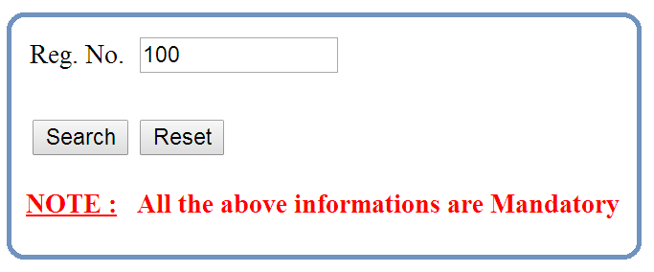
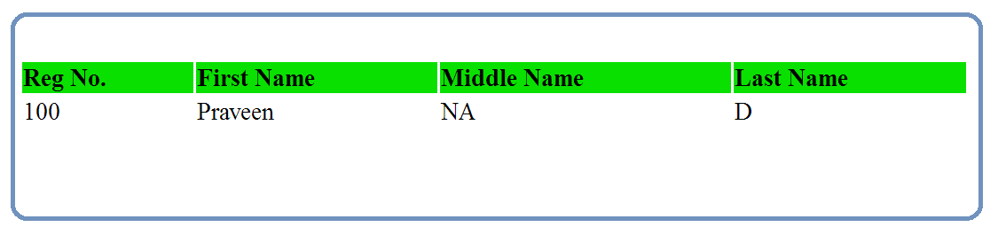
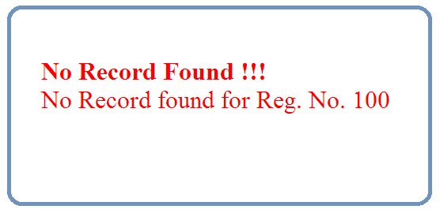
Servlet
JDBC
Driver
DB

Slide 38
DAO Interface
DAO interface exposes only the relevant data access methods to other programs
DAO Implementation 1
One / More Data Access Implementation Concrete Class
These Classes implement the Interface & provide their own implementation logic depending on data access mechanism we want to use
For Example, One Implementation Class uses JDBC way of interacting with DB other uses Hibernate way etc.,
DAO Implementation 2
DAO Implementation N

Slide 39
HTTP Header
< Single Empty Line >
HTTP Body

Slide 40
Web Server
Raw HTTP
Response
Raw HTTP
Request
Servlet Container
web.xml
Browser
1. MyFirstServlet
extends HttpServlet
/currentDate
Computer
doGet (HSR, HSR)
2. LoginServlet
extends HttpServlet
/login
doGet (HSR, HSR)
doPost (HSR, HSR)

Slide 41
Raw Http Response
Raw Http Request
HttpServletResponse
HttpServletRequest

Slide 42
Web Server
Response
Request
Servlet Container
web.xml
Browser
1. MyFirstServlet
extends HttpServlet
/currentDate
Computer
doGet (HSR, HSR)
2. LoginServlet
extends HttpServlet
/login
doGet (HSR, HSR)
doPost (HSR, HSR)
3. MyGenericServlet
extends GenericServlet
/myGeneric
service (SR, SR)

Slide 43
Web Server
Response
Request
Servlet Container
web.xml
1. MyFirstServlet
extends HttpServlet
/currentDate
service(SR, SR)
service(HSR, HSR)
doGet (HSR, HSR)
6 doXXX(HSR, HSR)
Browser
Computer
2. LoginServlet
extends HttpServlet
/login
service(SR, SR)
service(HSR, HSR)
doGet (HSR, HSR)
doPost (HSR, HSR)
5 doXXX(HSR, HSR)
3. MyGenericServlet
extends GenericServlet
/myGeneric
service (SR, SR)

Slide 44
Servlet Lifecycle Phases
Servlet.java
(Interface)
GenericServlet.java
(Abstract Class)
HttpServlet.java
(Abstract Class)
1. Instantiation
init (SC) {
-----
this.init();
}
init () { }
Empty Method
Inherited
2. Initialization
public void init (ServletConfig)
throws ServletException
service (SR, SR)
service (HSR, HSR)
One of 7
doXXX (HSR, HSR)
public void service (ServletRequest,
ServletResponse)
throws ServletException,
IOException
3. Service
Abstract Method
4. Destruction
public void destroy ()
destroy () { }
Empty Method
Inherited

Slide 45
GenericServlet.java
(Abstract Class)
HttpServlet.java
(Abstract Class)
service (SR, SR)
{
if (HTTP or HTTPS) {
service (HSR, HSR)
} else {
throw ServletException(“Non HTTP Request”);
}
}
service (HSR, HSR)
{
1. Get the HTTP Method from Request
2. Invoke one of the (out of 7)
Corresponding doXXX(HSR, HSR) Method
3. If HTTP method is CONNECT then,
generate “501 Error Response”
}
7 doXXX (HSR, HSR) {
Generate “405 Error Response”
}
Abstract Method
public void service (ServletRequest,
ServletResponse)
throws ServletException, IOException

Slide 46
Servlet.java
(Interface)
GenericServlet.java
(Abstract Class)
HttpServlet.java
(Abstract Class)
HttpJspBase.java
(Abstract Class)
init (SC) {
this.init();
}
init () { }
Empty Method
final init (SC) {
jspInit();
_jspInit();
}
jspInit() { } Empty Method
_jspInit() { } Empty Method
Inherited
init (SC)
service (SR, SR)
service (HSR, HSR)
doXXX (HSR, HSR)
service (SR, SR) Inherited
final service (HSR, HSR) {
_jspService (HSR, HSR);
}
_jspService (HSR, HSR);
Abstract Method
service (SR, SR)
Abstract Method
final destroy () {
jspDestroy ();
_jspDestroy ();
}
jspDestroy() { } Empty Method
_jspDestroy() { } Empty Method
destroy ()
destroy () { }
Empty Method
Inherited

Slide 47
HttpJspBase.java (Abstract Class)
Translated Servlet i.e. Java (Concrete Class)
final init (SC) {
jspInit();
_jspInit();
}
jspInit() { } Empty Method
_jspInit() { } Empty Method
Can’t Override but we can Inherit
Can Override or Inherit
Can’t Override because Container uses this method
service (SR, SR) Inherited
final service (HSR, HSR) {
_jspService (HSR, HSR);
}
_jspService (HSR, HSR);
Abstract Method
Can Override (but we should not) or Inherit
Can’t Override but we can Inherit
Can’t Override because Container uses this method
final destroy () {
jspDestroy ();
_jspDestroy ();
}
jspDestroy() { } Empty Method
_jspDestroy() { } Empty Method
Can’t Override but we can Inherit
Can Override or Inherit
Can’t Override because Container uses this method

Slide 48
Request
Get the
Servlet Name from web.xml
Servlet Instance
exists in cache?
Create an
Instance of a Servlet
[ Public Default Constructor ]
NO
YES
Invoke
service (SR, SR) method
Initialize a Servlet
[ invoke init (SC) method ]
Response

Slide 49
Gmail (Assume it’s a J2EE Web Application
Type www.gmail.com URL
LoginPageServlet extends HttpServlet
doGet (HSR, HSR) {
//Logic to Generate Login Page
}
Login Page
User Name & Password
Login Page / Inbox Page
InboxPageServlet extends HttpServlet
doPost (HSR, HSR) {
// Logic to Generate Inbox Page
}
3. ComposeMailServlet extends HttpServlet
doGet (HSR, HSR) { Logic to Generate Popup}
3. SendMailServlet extends HttpServlet
doPost (HSR, HSR) { Logic to Send Mail }
3. SearchMailServlet extends GenericServlet
doGet (HSR, HSR) { Logic to Search Mail }
3. LogoutServlet extends GenericServlet
doGet (HSR, HSR) { Logic to Generate Login Page }

Slide 50
1
Kannada
Kannada
Kannada
Kannada
Kannada
Kannada
Kannada
Kannada
Kannada
Kannada
Accept he Request
& give 1000 Rs
ABC
You may not have the Money.
But you want to fulfill your
friend request. Hence you take the
help of you own friend
(Forward the Request)
Your friend gets the Money but he will not be aware of what went behind the scene

Slide 51
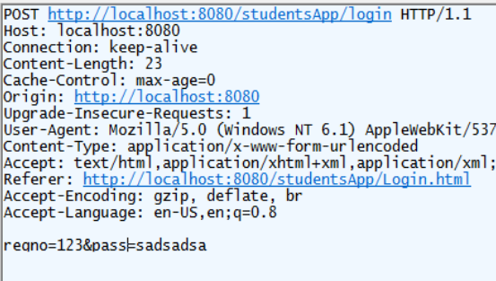
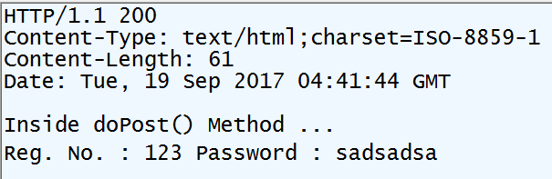
HttpServletRequest
HttpServletResponse
Raw Http Request
Raw Http Response

Slide 52
